Slide 1
EENG 385 Full Bridge Rectifier with Buck Converter
Notes:
Usually the <title of the lab> is what will be called the “System” through the rest of this document

Slide 2
Lab Objectives
Study the theory, simulation and implementation of a full-bridge rectifier and a switch mode DC-to-DC converter.

Slide 3
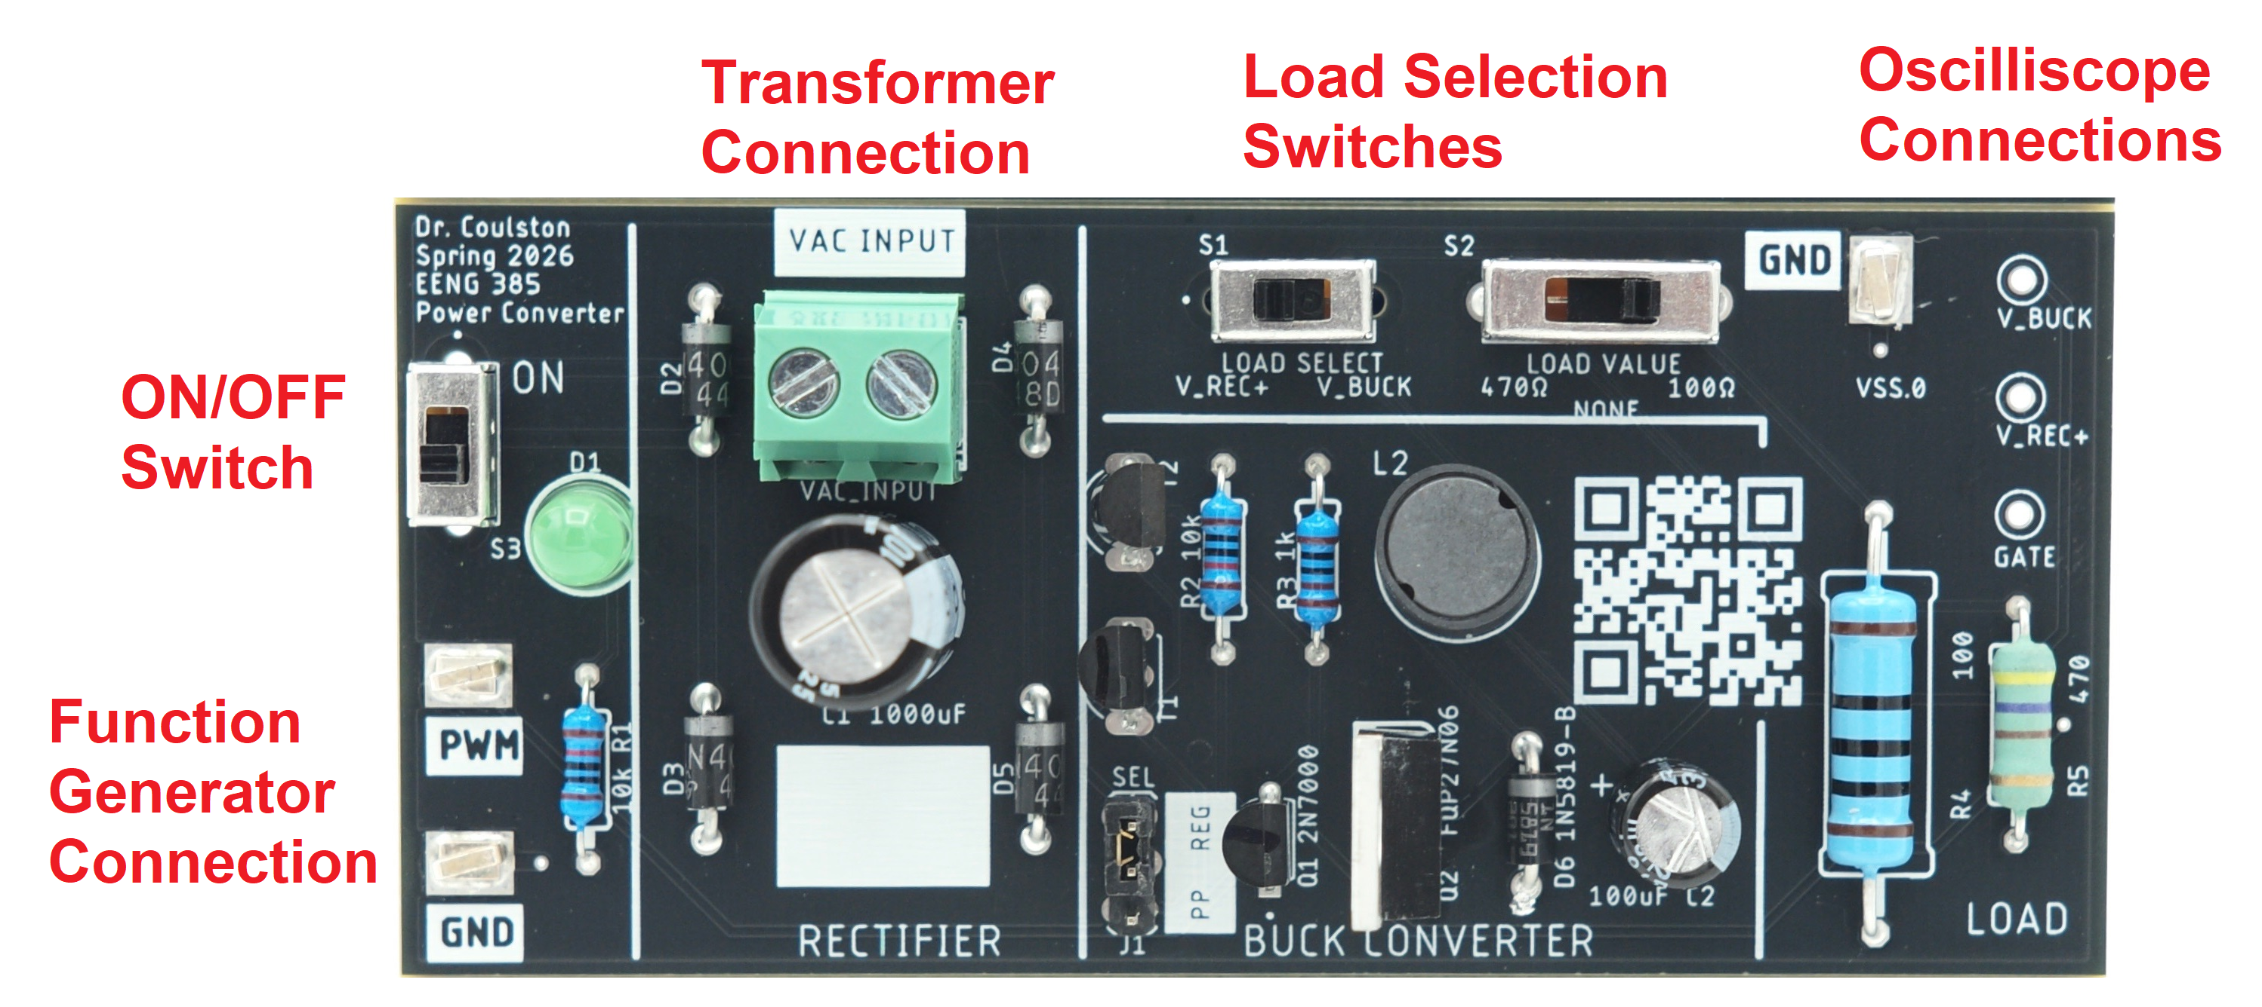
Power Conversion PCB
Bridge Rectifier – Converts 17VAC into 17VDC
Buck Converter – Steps 17VDC down using PWM duty cycle
Notes:
Replace <System> with the name of the

Slide 4
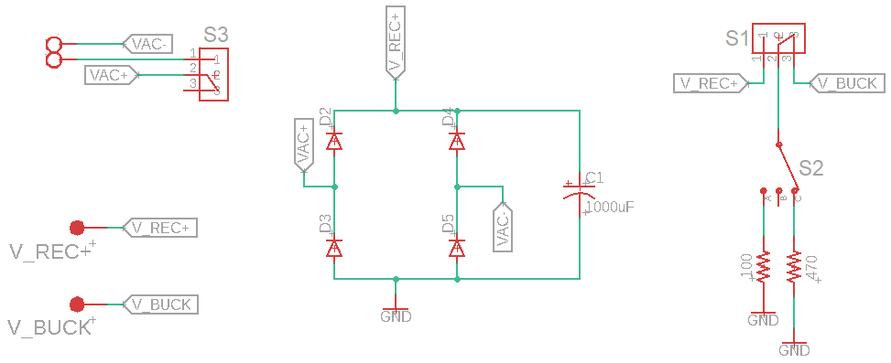
Full Bridge Rectifier
AC input Vac+/Vac- DC output Vrec+/GND
Diodes “correct” negative voltages, making them positive
Capacitor stores charges for when AC voltage dips low
Adjustable load S1
Probe points
Notes:
Replace <System> with the name of the

Slide 5
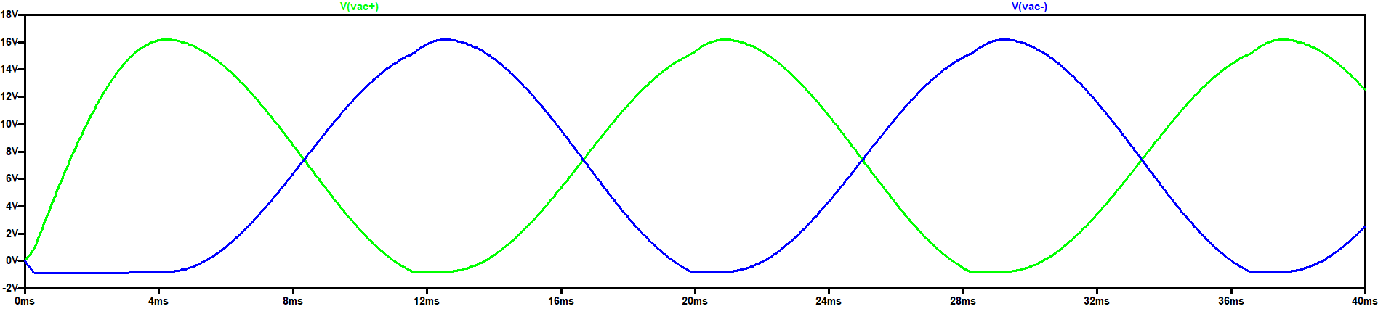
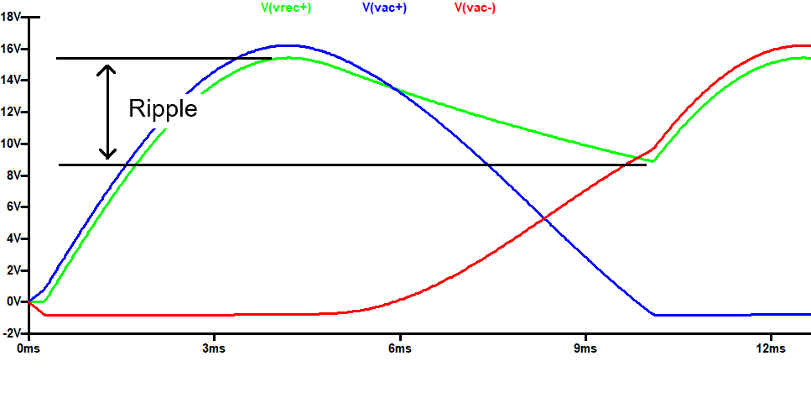
Full Bridge Rectifier
Input:
Output:
Small resistor +
Smaller capacitor =
Larger ripple
Notes:
Replace <System> with the name of the

Slide 6
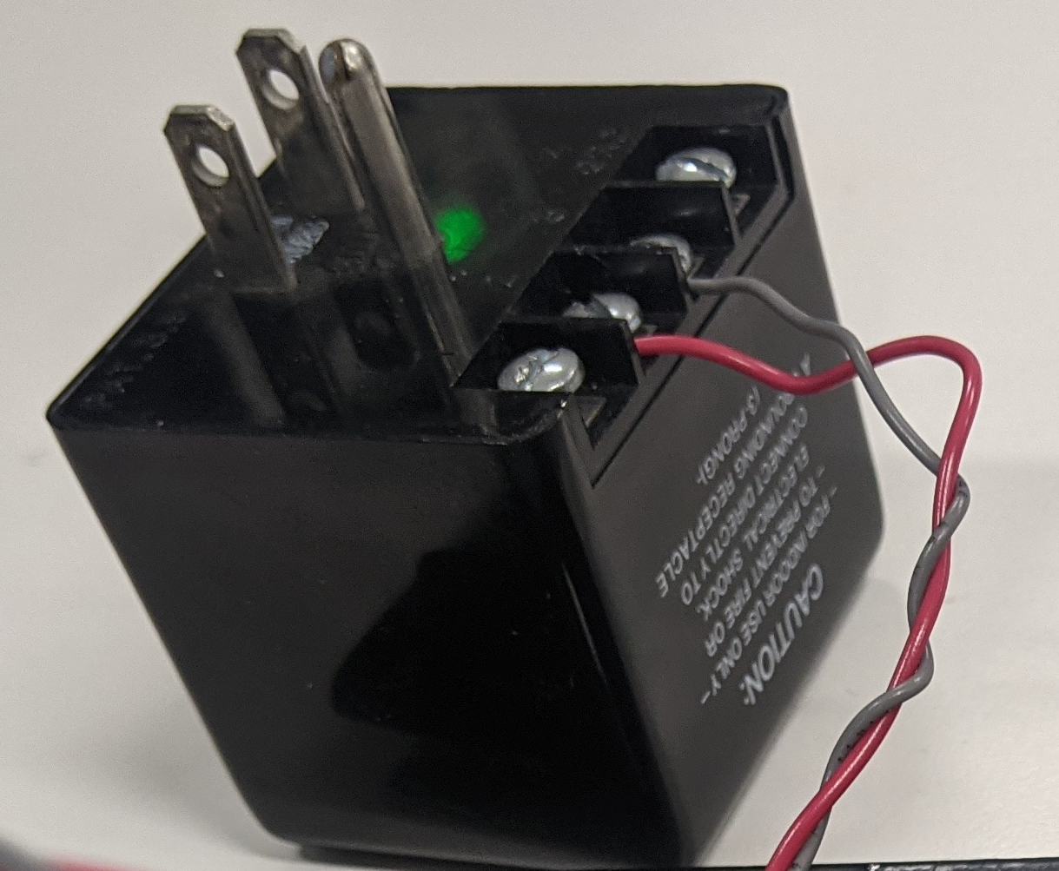
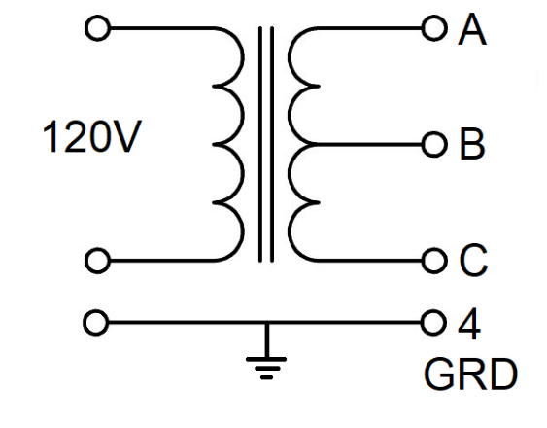
Mains Step-down transformer
KS21239L4 Transformer
Input 120VAC 3-prong plug
Output 4 screw-terminals
Voltage measured RMS
Notes:
Replace <System> with the name of the

Slide 7
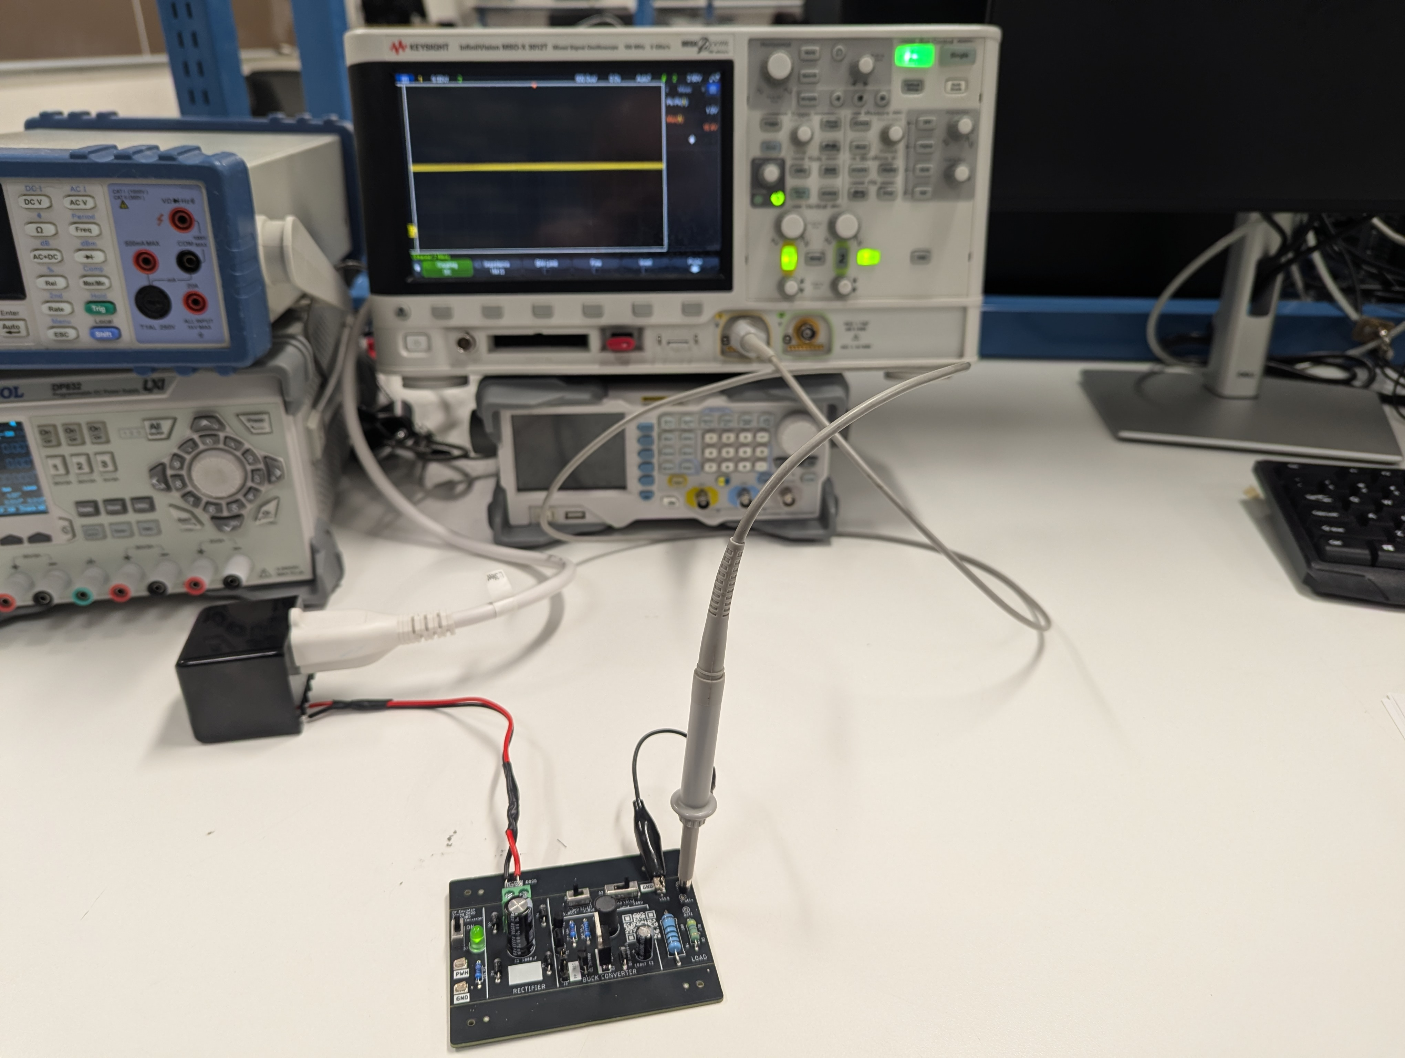
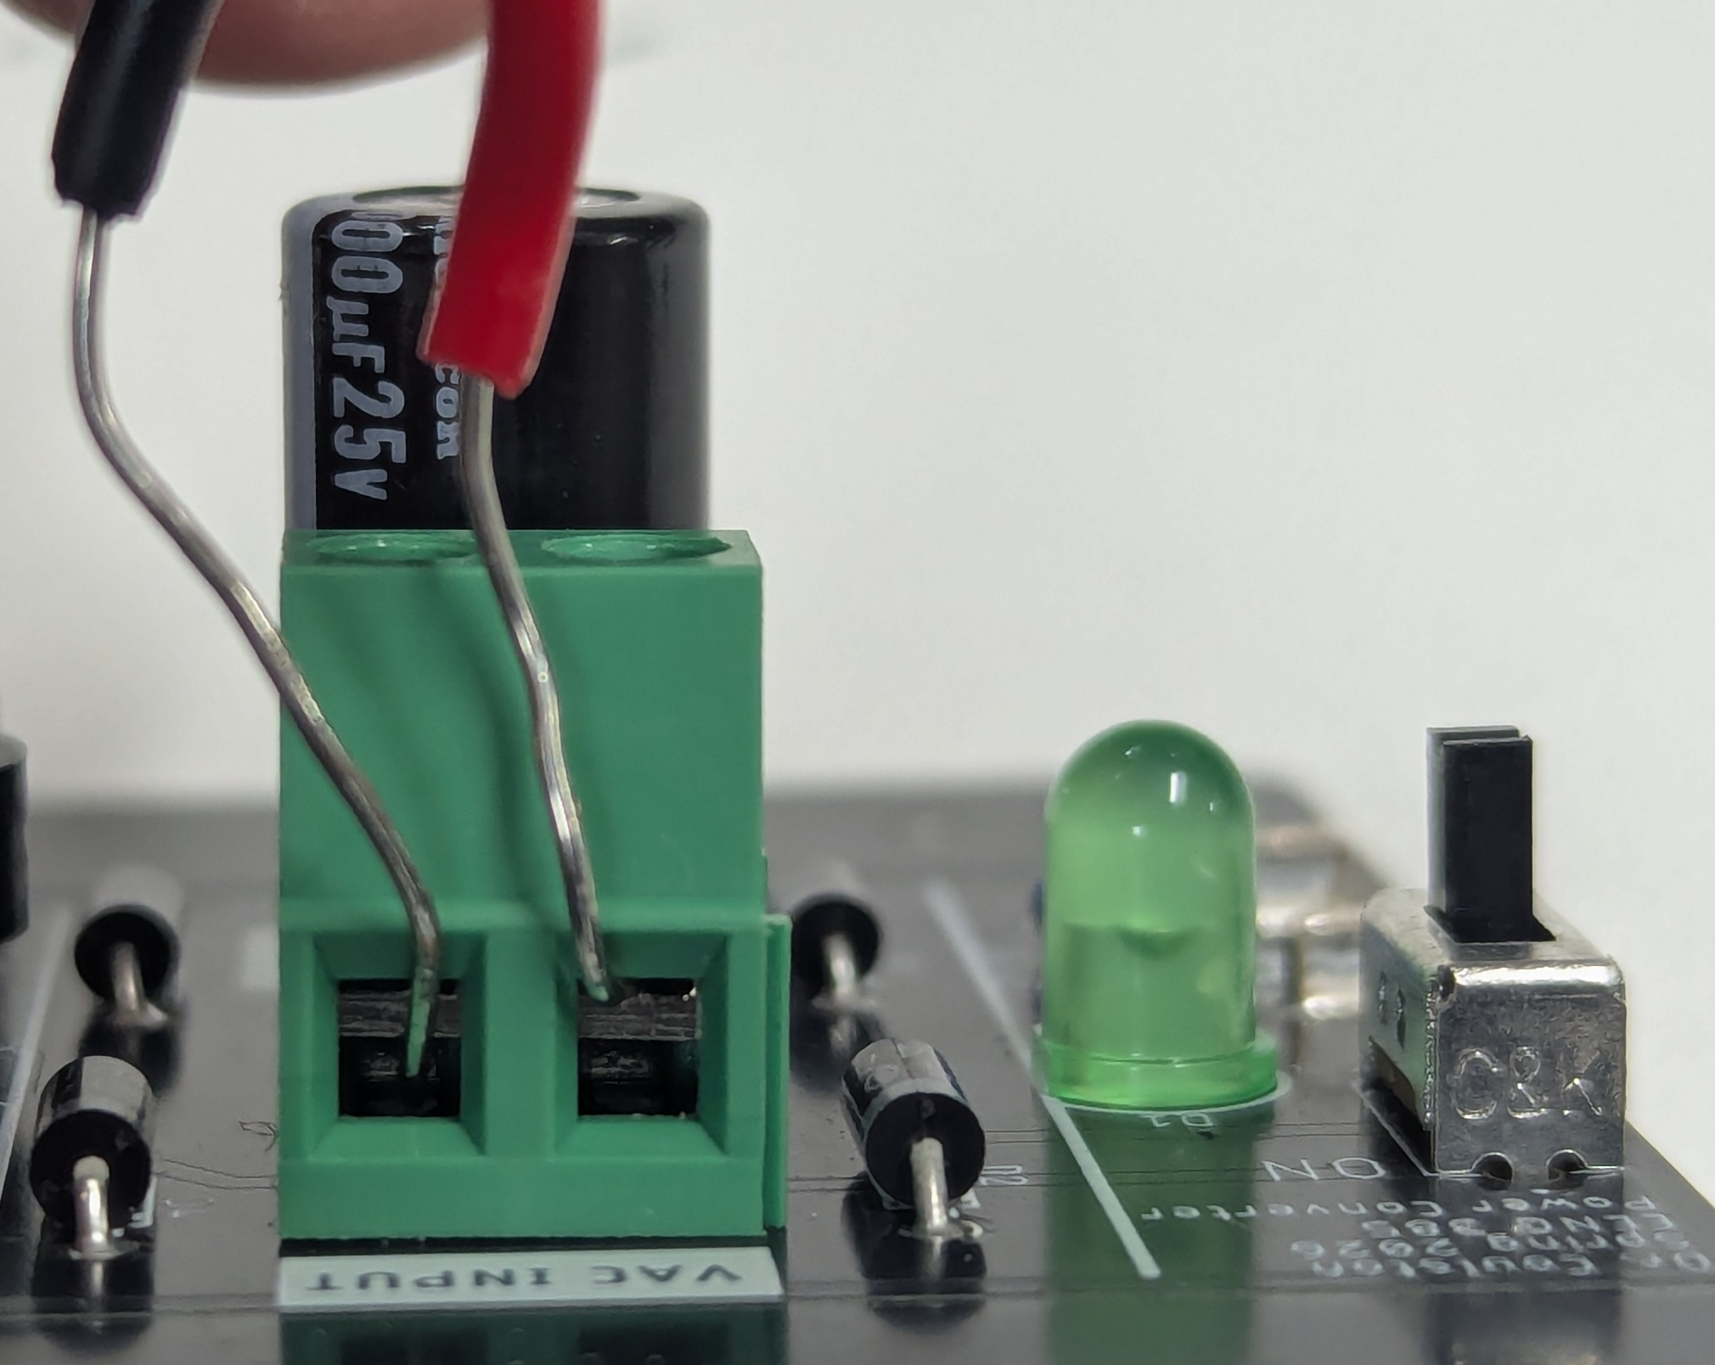
Full Bridge Rectifier
Implementation
VAC from transformer
Oscilloscope to Vrec+
Notes:
Replace <System> with the name of the

Slide 8
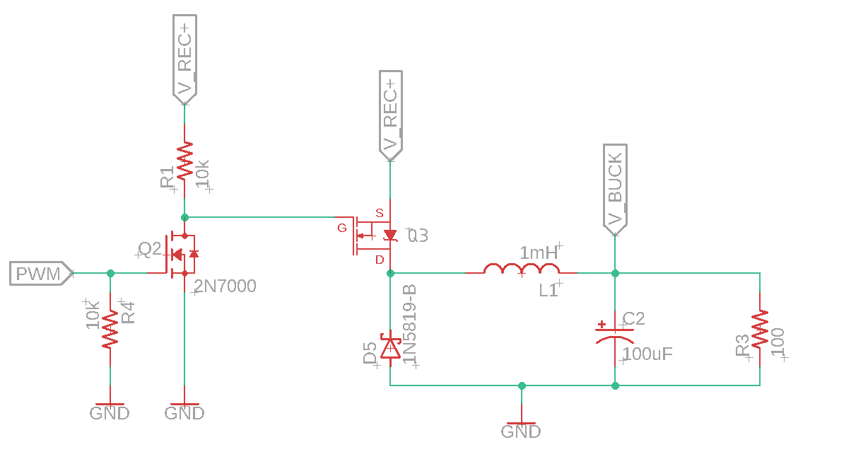
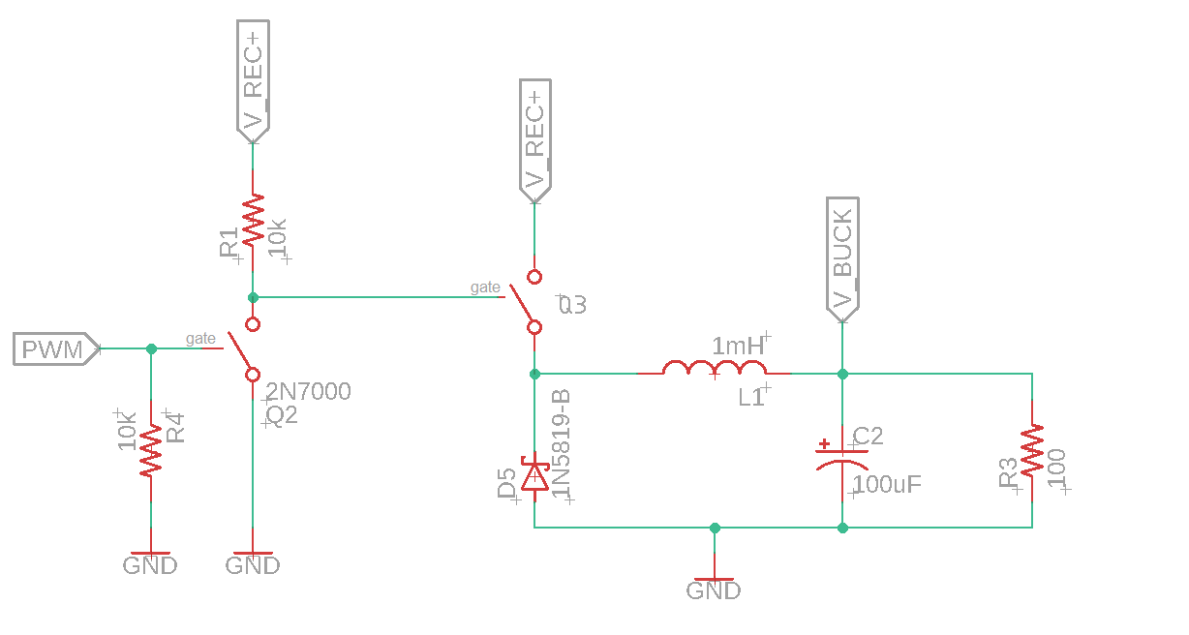
Buck Converter
V_REC+ from Bridge Rectifier
PWM duty cycle
V_BUCK is step down output
MOSFET Q2/Q3 are switches
Q2 Enables PWM to switch Q3
Q3 Closed charges L1/C2
Q3 Open discharges L1/C2

Slide 9
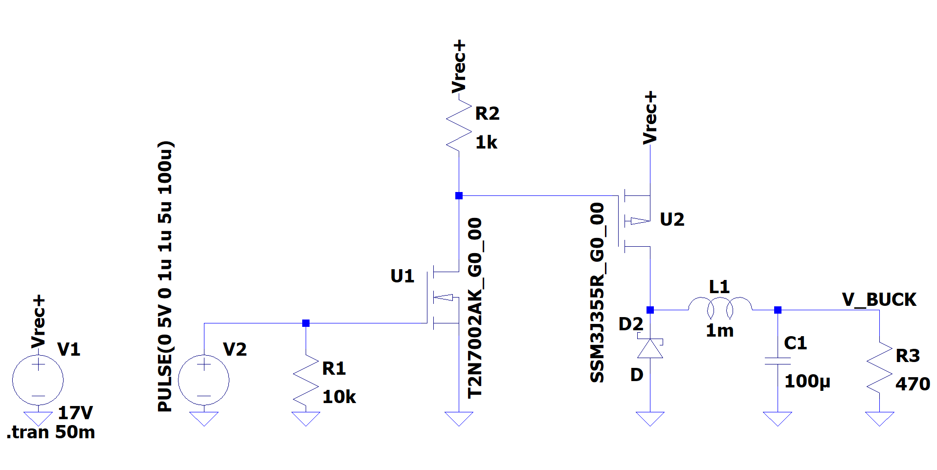
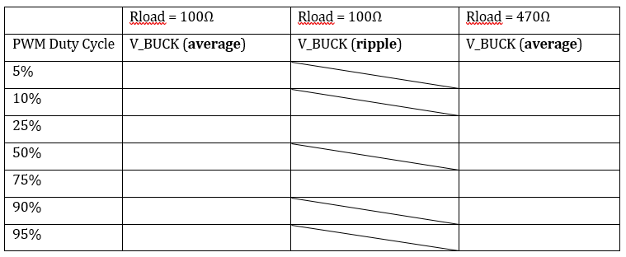
Buck Converter
Simulation
Adjust duty cycle and load
Record Vout DC (average)
Record Vout ripple

Slide 10
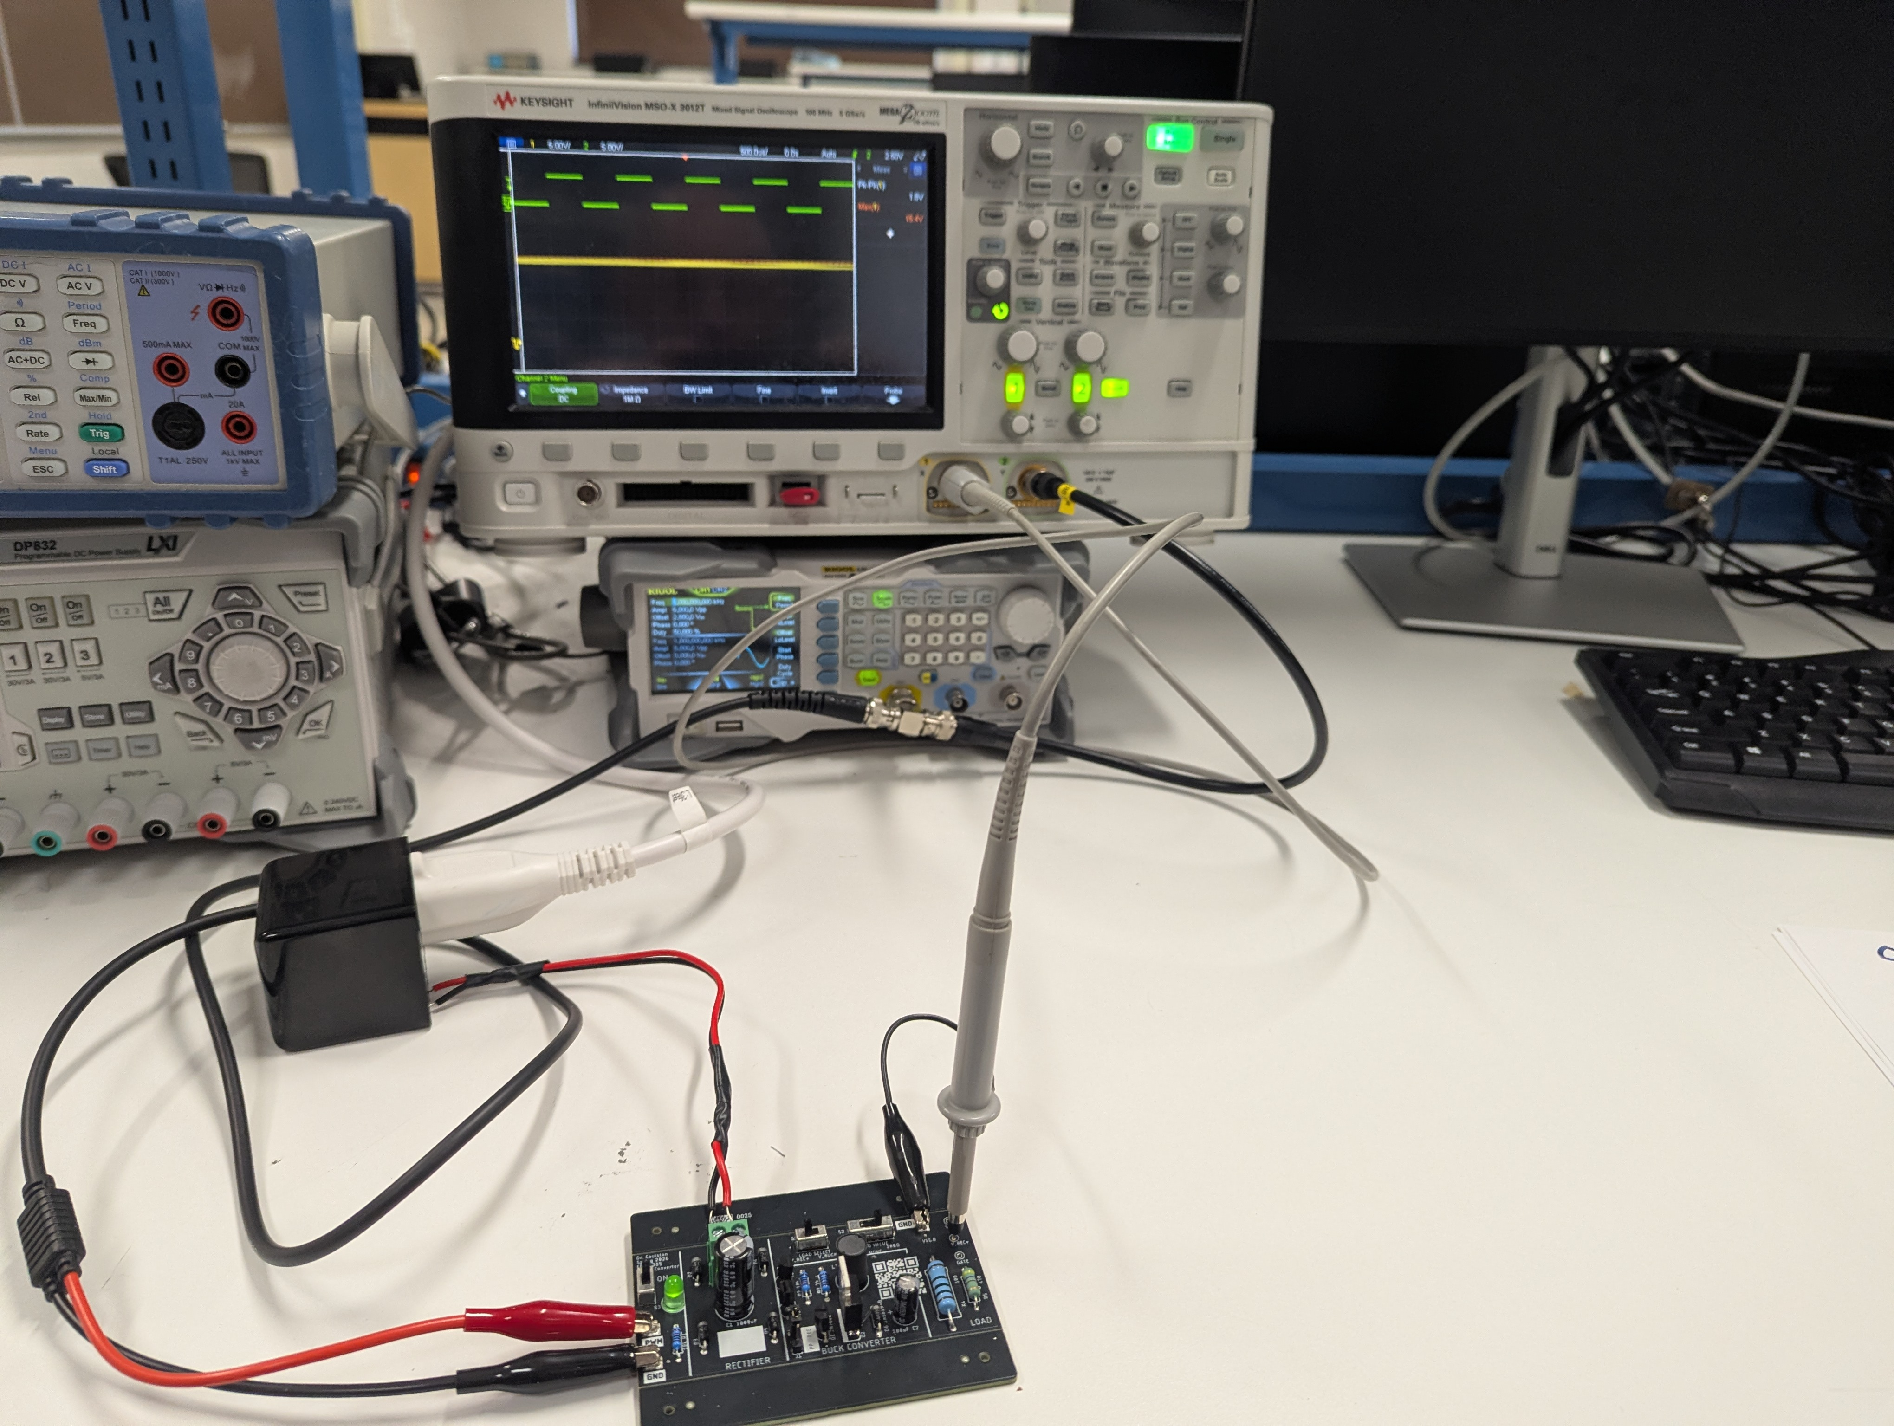
Buck Converter
Implementation
Adjust duty cycle and load
Record Vout DC (average)
Record Vout ripple

Slide 11
Turn In
Make a record of your response to numbered items below
Full Bridge Rectifier Theory
Steps 1 – 8
Full Bridge Rectifier Simulation
Table 1
Full Bridge Rectifier Implementation
Steps 1-7
Table 1
Oscilloscope trace with 100Ω and 470Ω load
Buck Converter Theory
PWM High Steps 1-5
PWM Low Steps 1-4
Buck Converter Simulation
Steps 1-6
Table 3
Buck Converter Implementation
Steps 1-4
Complete Table 4
Relationships 1-4

